Slide 1

Final Project Variant effect prediction: Three models for classifying pathogenic mutations in human genes
Kelly Brock
<https://github.com/kpgbrock/CS89_VariantEffectPrediction>
CSCI S-89 Introduction to Deep Learning
Summer 2022
Harvard Summer School

Slide 2
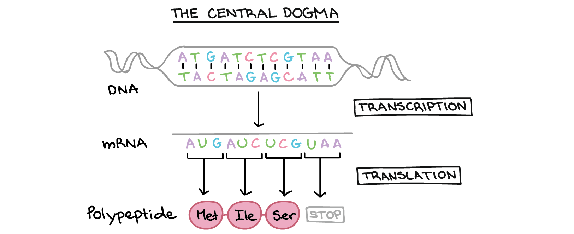
Biology primer: DNA, inherited from our parents, encodes for proteins (the building blocks of the cell)
Source: https://www.khanacademy.org/science/ap-biology/gene-expression-and-regulation/translation/a/intro-to-gene-expression-central-dogma

Slide 3
Missense variants occur when a DNA change leads to an amino acid (individual unit of polypeptide) change
C
G
C
Thr
Source: https://www.khanacademy.org/science/ap-biology/gene-expression-and-regulation/translation/a/intro-to-gene-expression-central-dogma

Slide 4
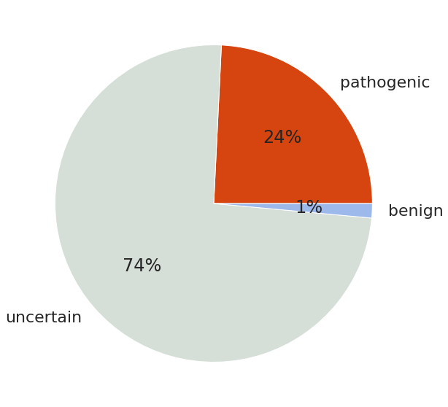
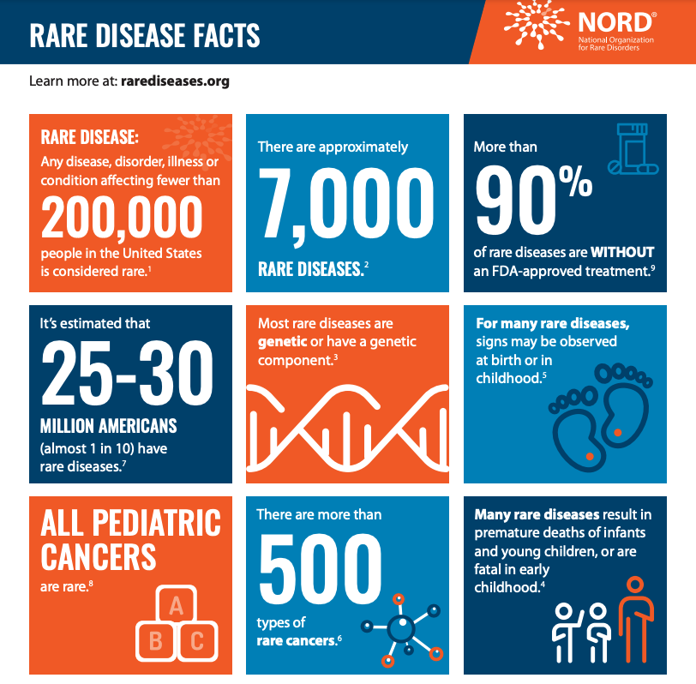
Variant effect prediction is a major challenge in clinical genetics
Roughly 1 in 10 people in the US have a rare disorder (many genetic) . . .
. . . However, many missense variants remain of uncertain significance!
Data from ClinVar 2020
(missense variants with coarse-grained labels)
https://rarediseases.org/wp-content/uploads/2021/06/NRD-2149-2021_Sell-Sheet_RareInsights-Fact-Sheet_FNL-1.pdf

Slide 5
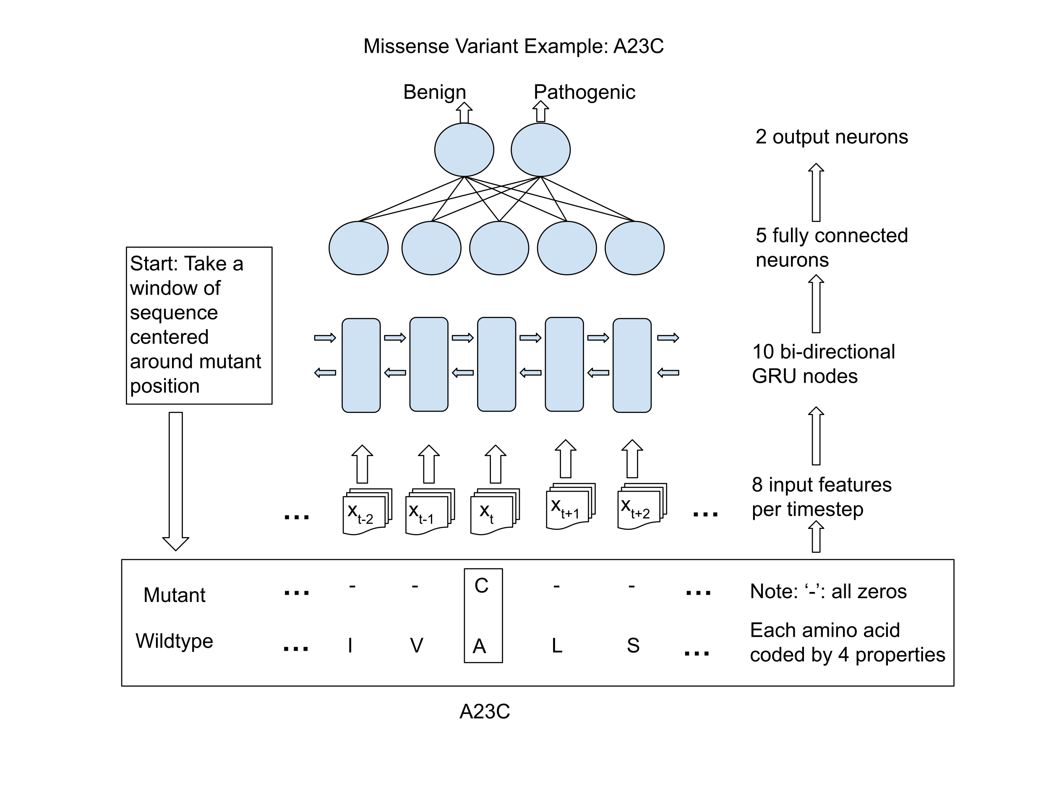
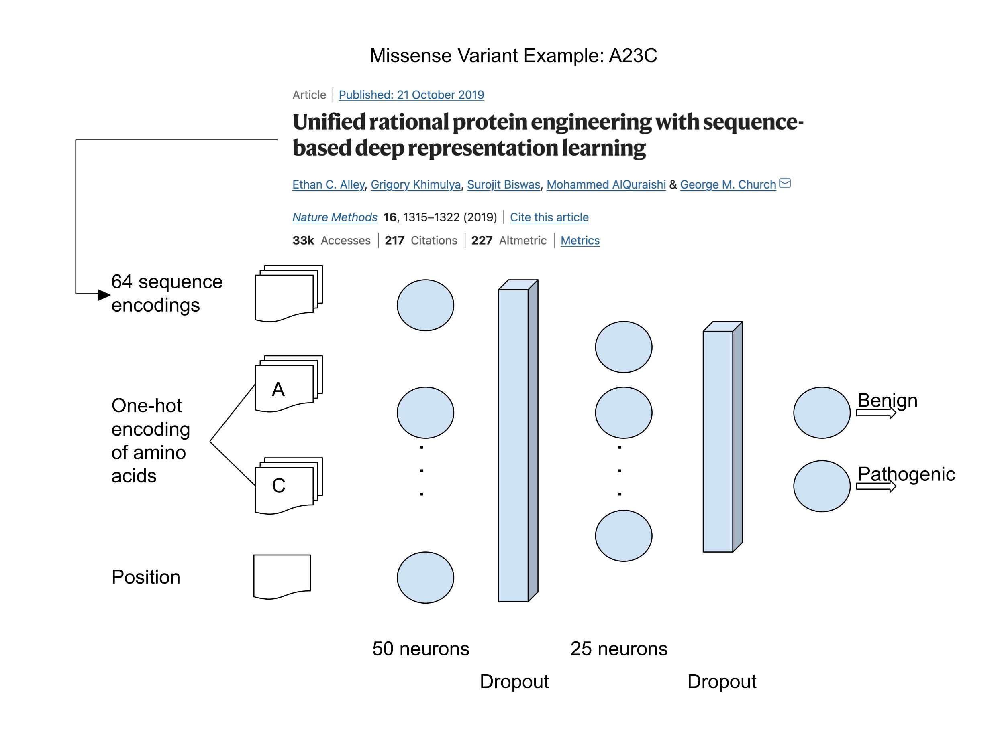
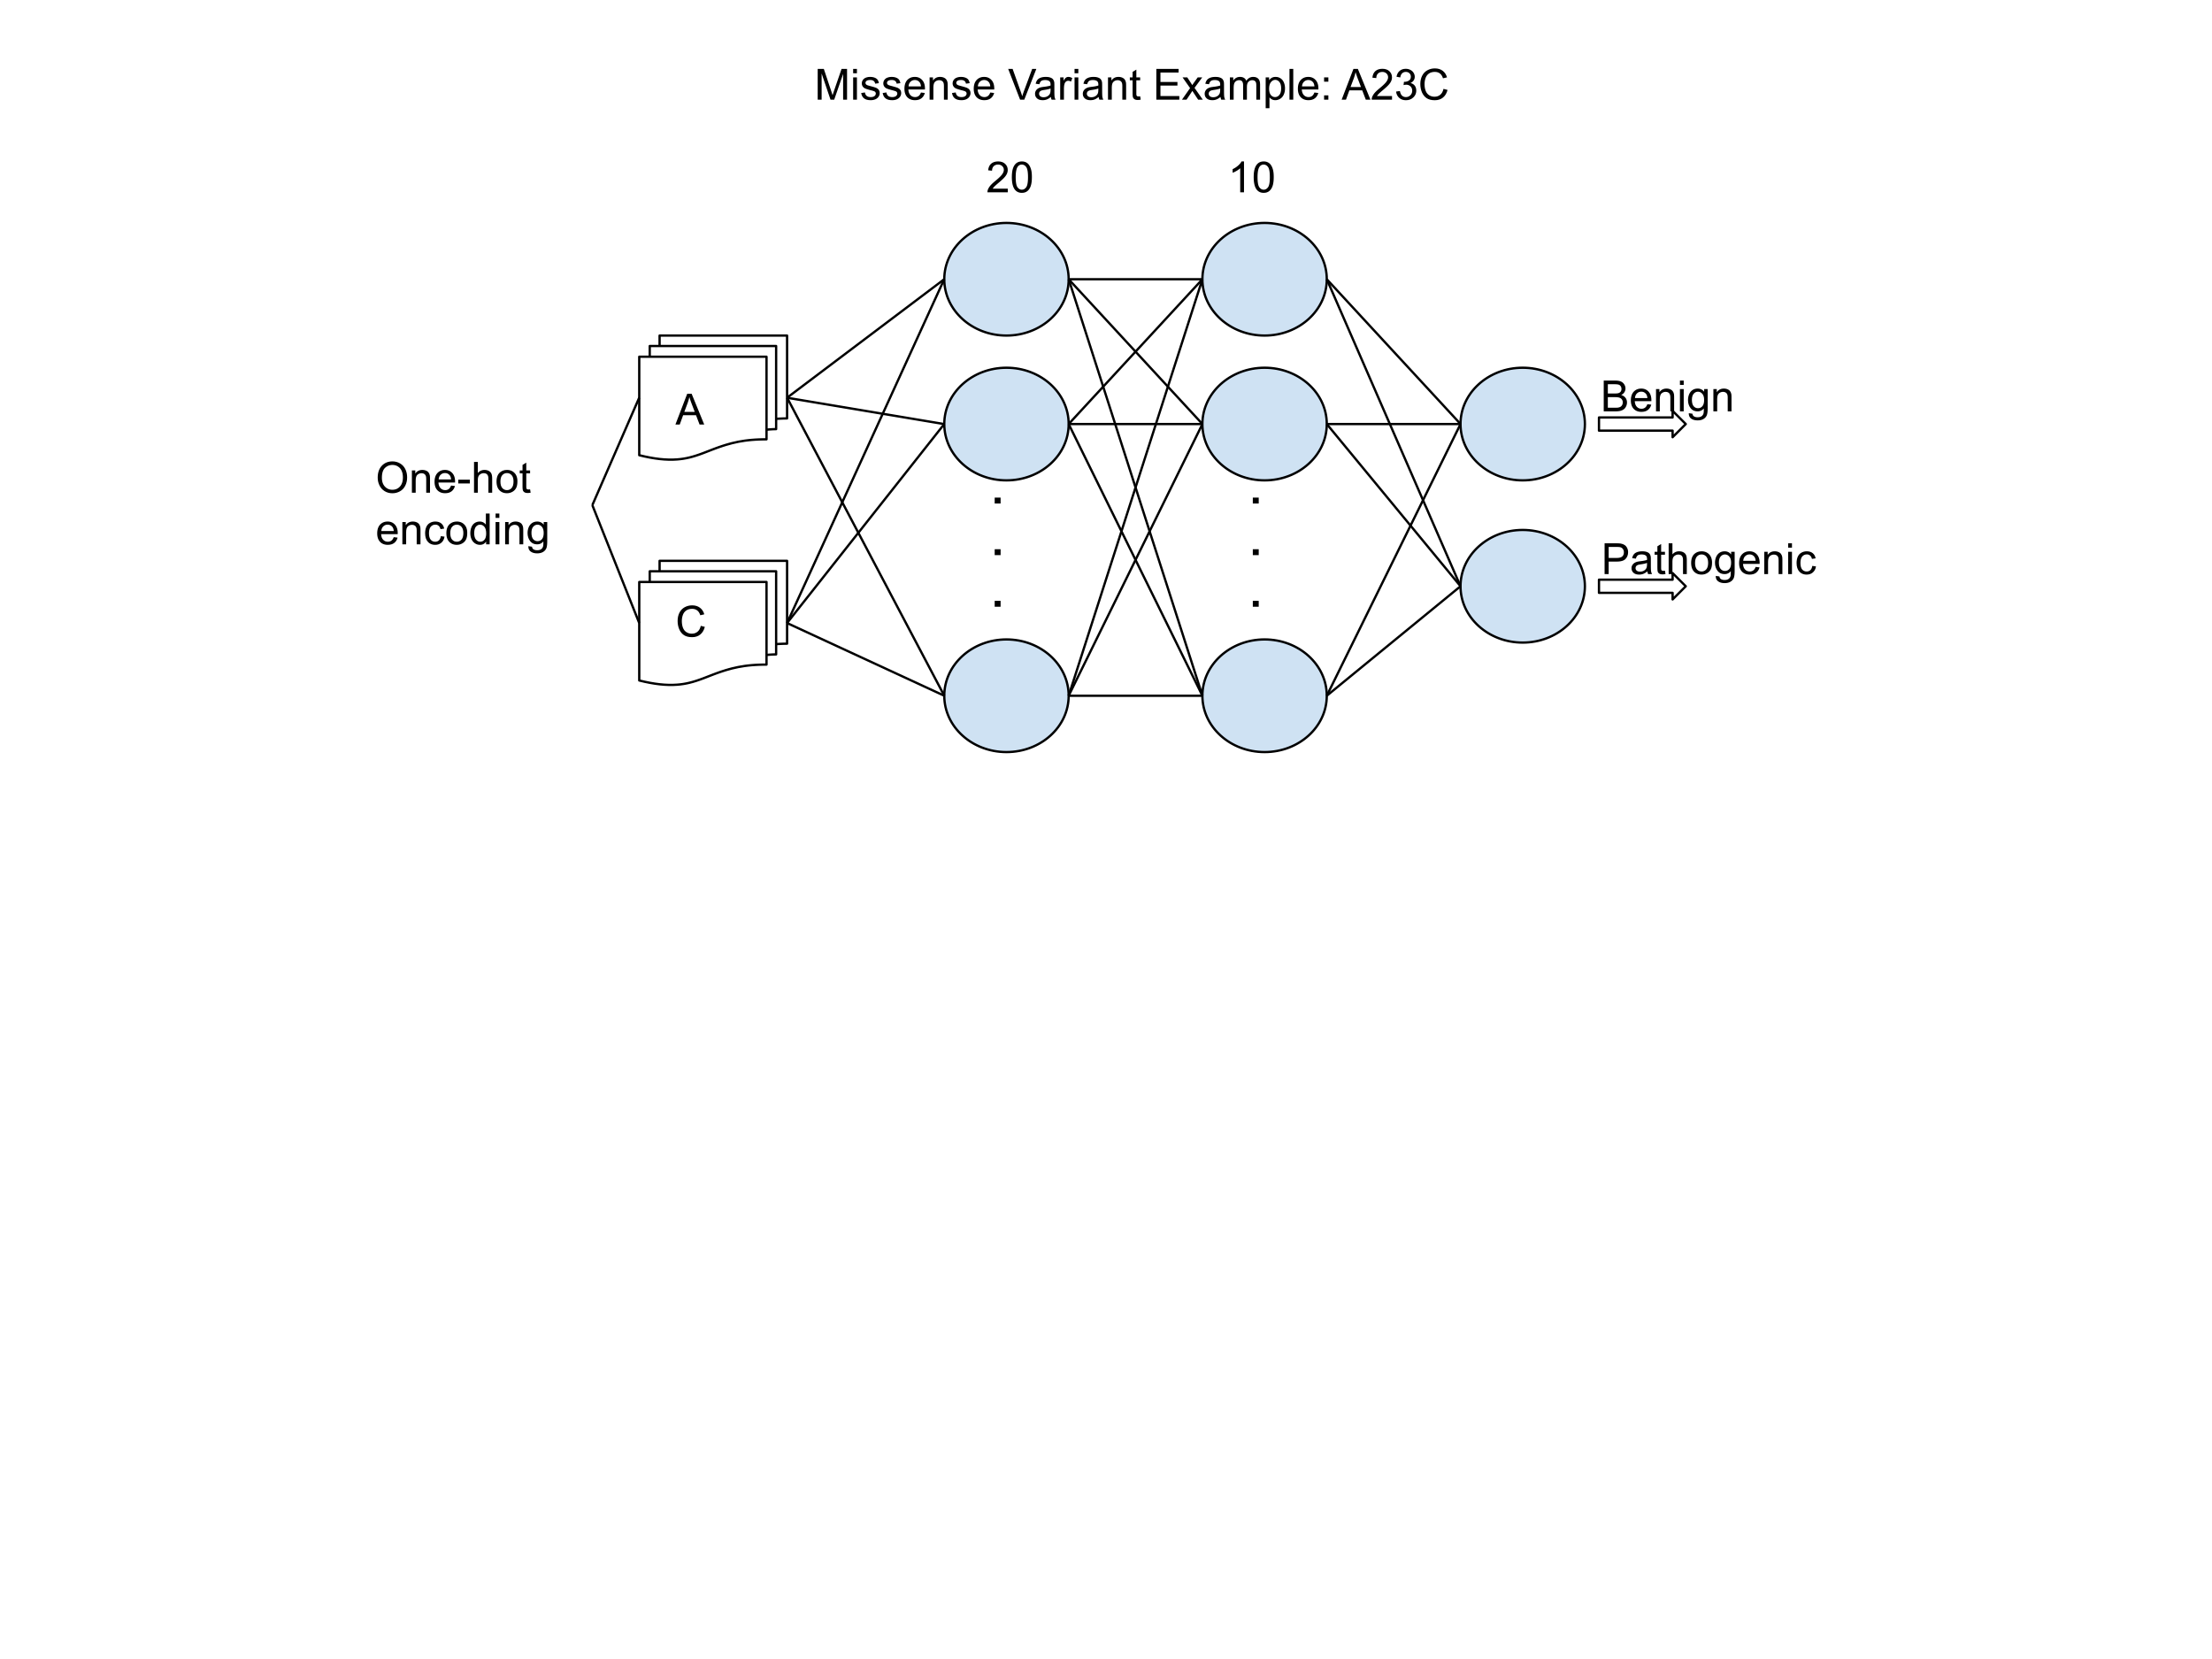
Goal: build supervised classifiers incorporating different levels of input for variant effect prediction
Model 1
Model 2
Model 3
Input: Wildtype (wt) and mutant (mut)
amino acid
Input: Sequence window and
wt + mut amino acid properties
Input: Encoding for full sequence and
wt + mut amino acid

Slide 6
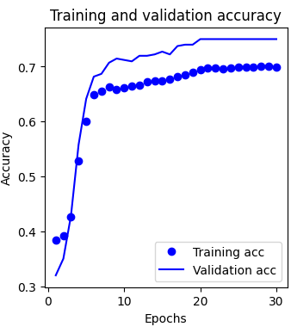
Model 1: What can we tell just from encoding the wildtype and the mutant amino acid?

Slide 7
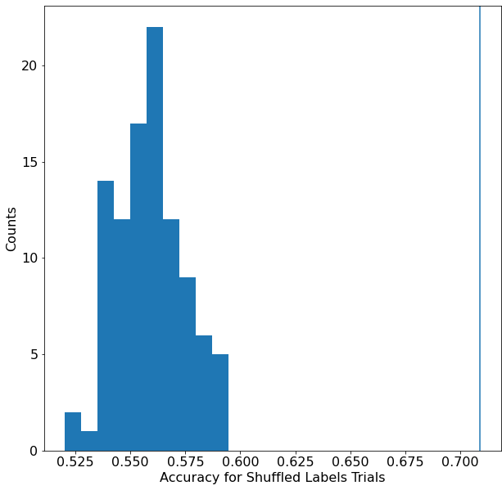
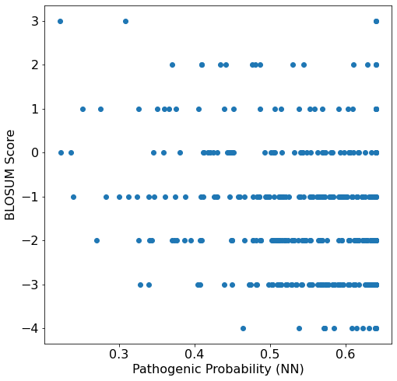
Model 1: Our model is learning something, and has some overlap with the BLOSUM62 matrix
How much better do we do than random chance?
Comparison of predictions to BLOSUM62
Actual test accuracy
Henikoff & Henikoff, PNAS 1992.

Slide 8
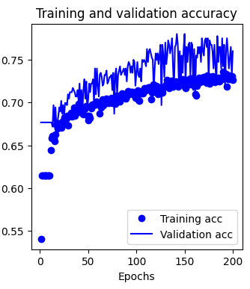
Model 2: Add in a sliding window of the surrounding protein sequence to a bi-directional GRU layer
‘Clustered’ train/validate/test split

Slide 9

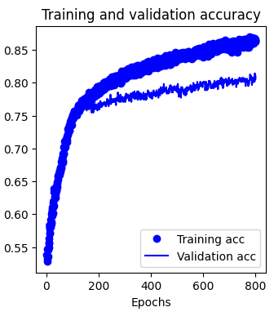
Model 3: Input the full-length sequence using pretrained encodings
‘Random’ train/validate/test split

Slide 10
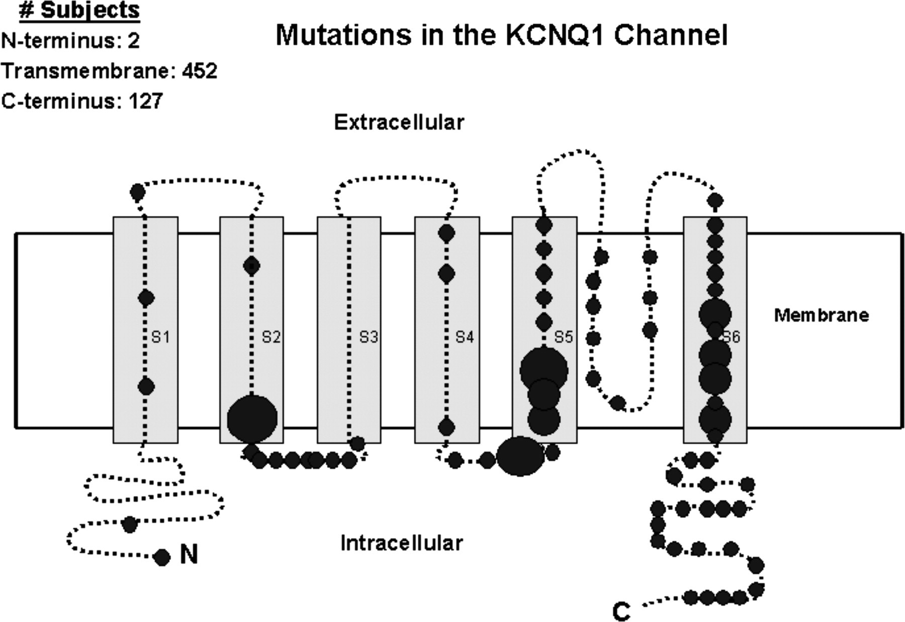
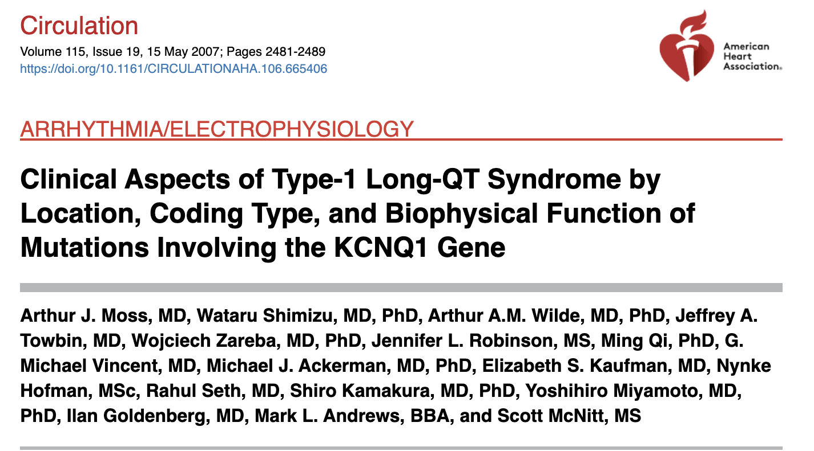
Case study: predict all possible missense mutations for KCNQ1 protein product

Slide 11
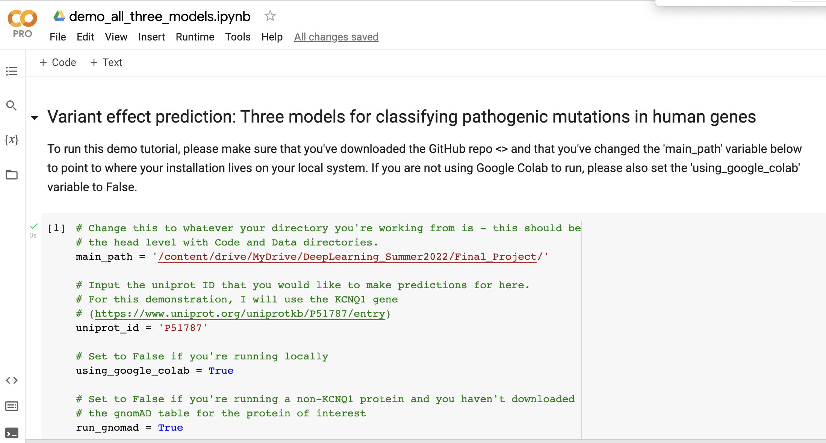
There is a tutorial notebook to demonstrate the different models – Code/demo_all_three_models.ipynb
Note: to run this notebook, please change these variables as needed!

Slide 12
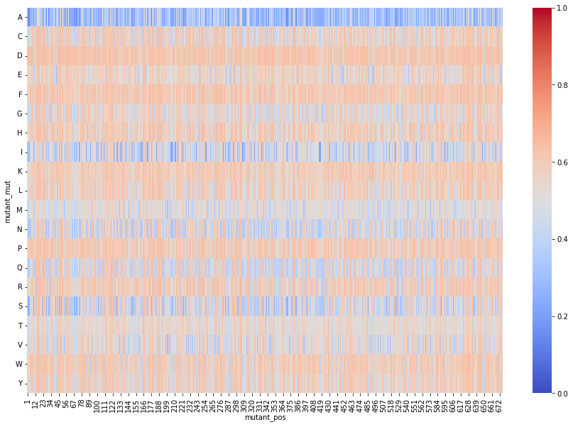
Model 1: Predicted pathogenicity for all KCNQ1 missense variants for amino acid substitution input
Akin to alanine scanning!
More pathogenic
Amino acid
More benign
Residue position

Slide 13
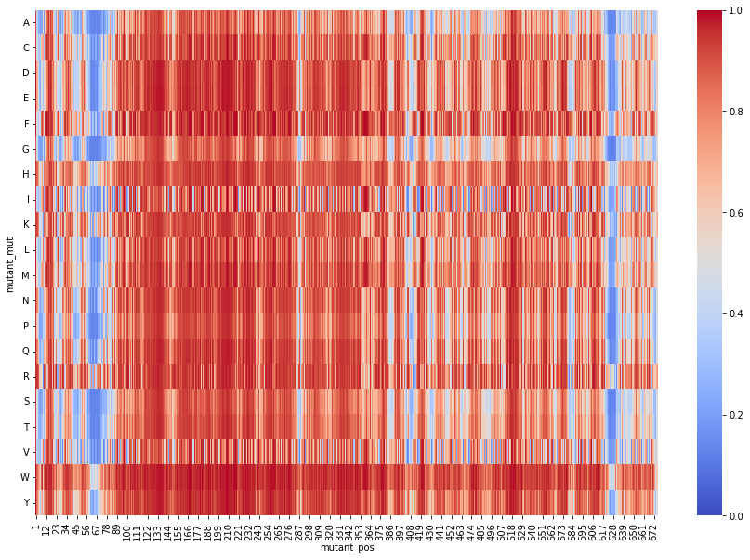
Model 2: Predicted pathogenicity for all KCNQ1 missense variants for sequence window input
Predictions reflect known domain boundaries!
More pathogenic
Amino acid
More benign
Residue position

Slide 14
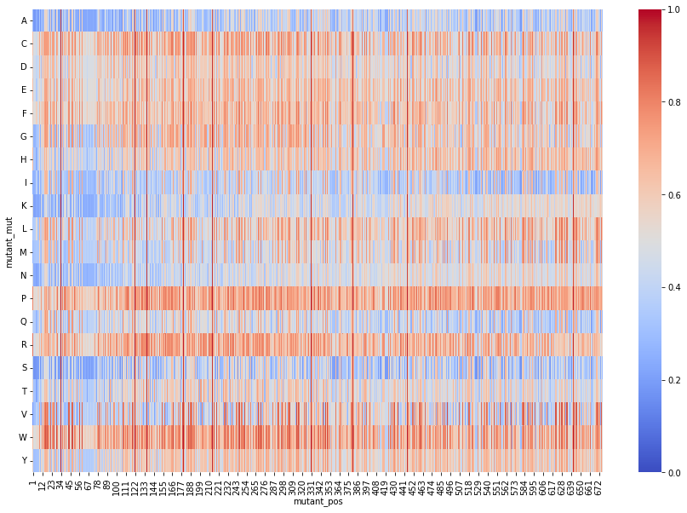
Model 3: Predicted pathogenicity for all KCNQ1 missense variants for full sequence encodings
More pathogenic
Amino acid
More benign
Residue position

Slide 15
Pros, Cons, and Lessons Learned
All three models can learn valuable information about predicting pathogenicity, even with minimal information
Train/validate/test split is important, and overfitting is a definite challenge
Tuning Model 2 (the bi-directional GRU) was very challenging, but can potentially be improved
I gained a much better understanding of how to approach real-world problems, including input feature selection
Thank you for a wonderful class!

Slide 16
Youtube Presentation and GitHub links
Youtube video of presentation: <https://www.youtube.com/watch?v=qcD5TAge05U>
GitHub repo with all code: <https://github.com/kpgbrock/CS89_VariantEffectPrediction>

